Slide 1
ASME Design Team Getting Started Part I
For Questions, email Greg at gihanson@wisc.edu

Slide 2
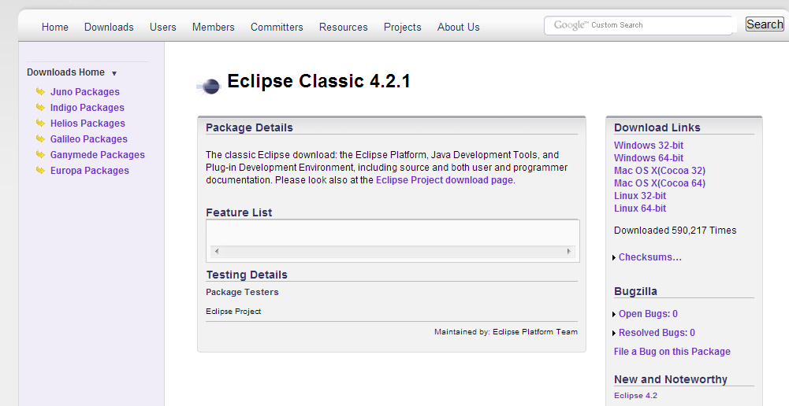
Download Eclipse
Download Link: http://www.eclipse.org/downloads/packages/eclipse-classic-421/junosr1
Click the download link that applies to your operating system

Slide 3
Git and GitHub
Git is a revision control tool for code. https://github.com/ is a free site where your code is actually hosted.
The general idea is that you can pull a copy of the code from github make changes, and then push those changes back to github.
When you push a change a new revision is created. When you pull you get the latest revision, but at any point you can also access a specific revision – meaning it is very hard to lose code
The following slides will help you set up Git

Slide 4
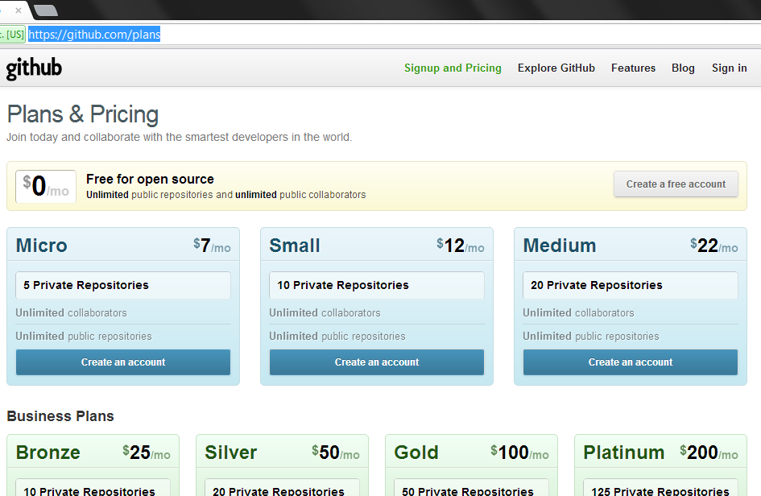
Sign-up with GitHub
Set up a free account here: https://github.com/plans

Slide 5
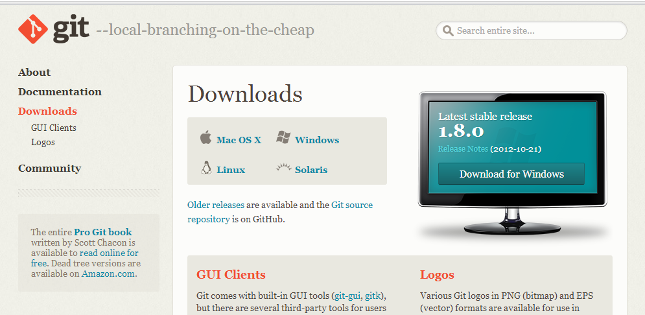
Get Git
Download Git here: http://git-scm.com/downloads
Select The download link that corresponds to your operating system

Slide 6
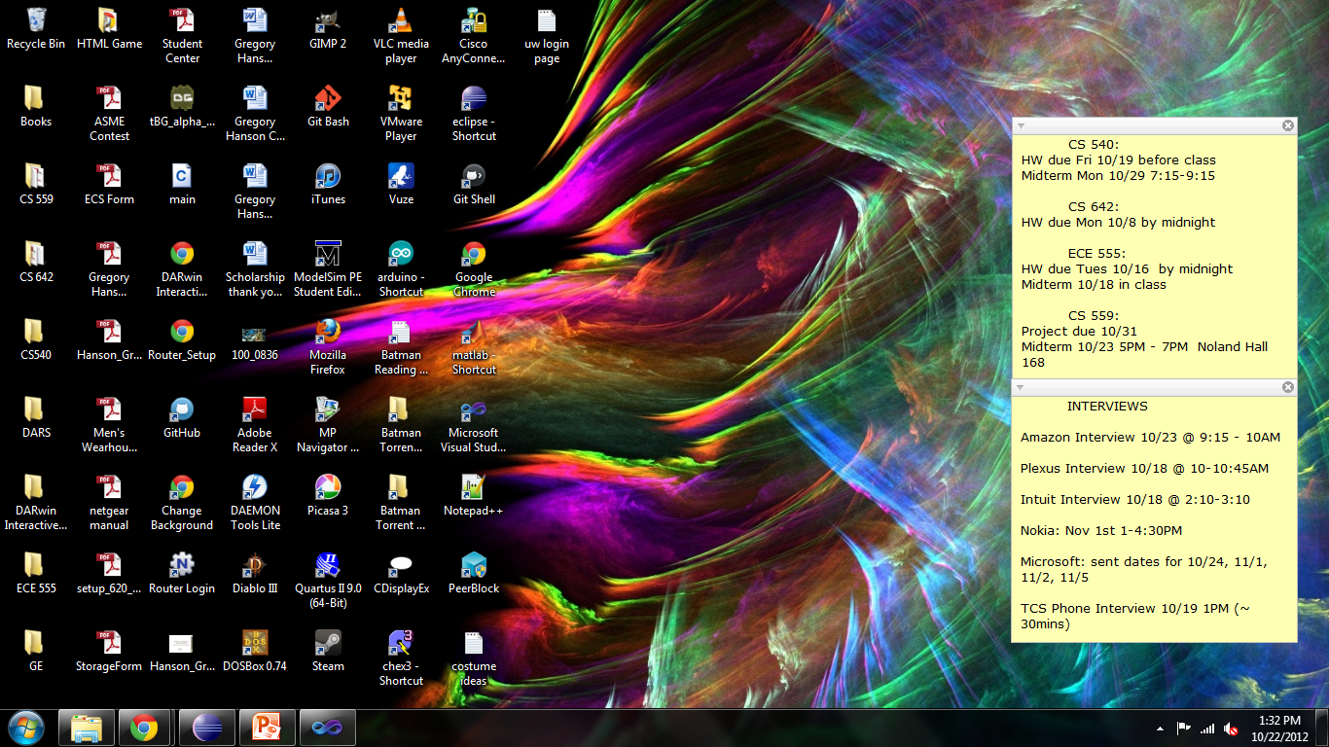
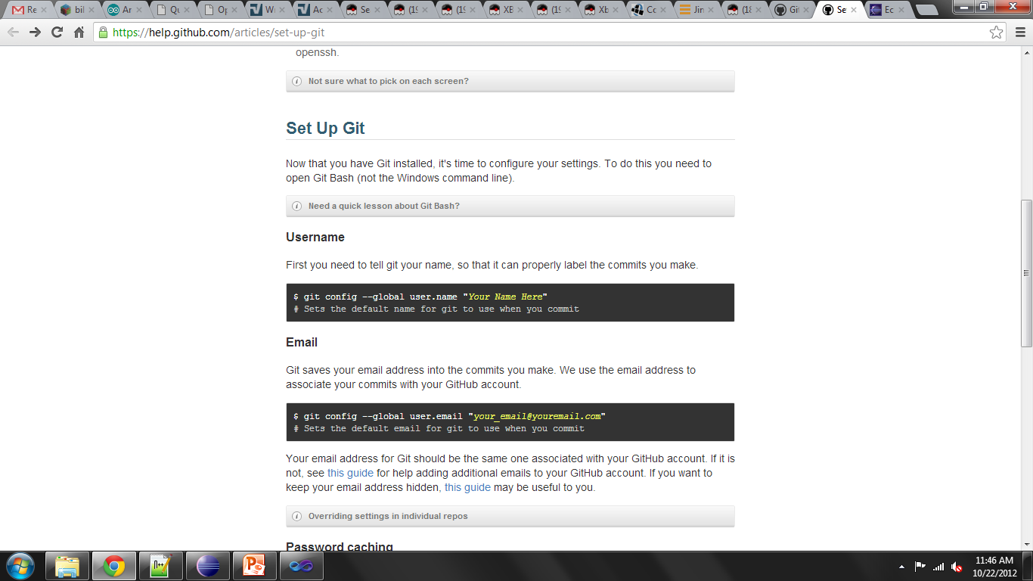
Set Up Git: Part I (Optional)
Follow the instructions here https://help.github.com/articles/set-up-git beginning with “Set Up Git” portion
Hint: Git Bash, , should have installed in the previous step and a shortcut icon placed on your desktop

Slide 7
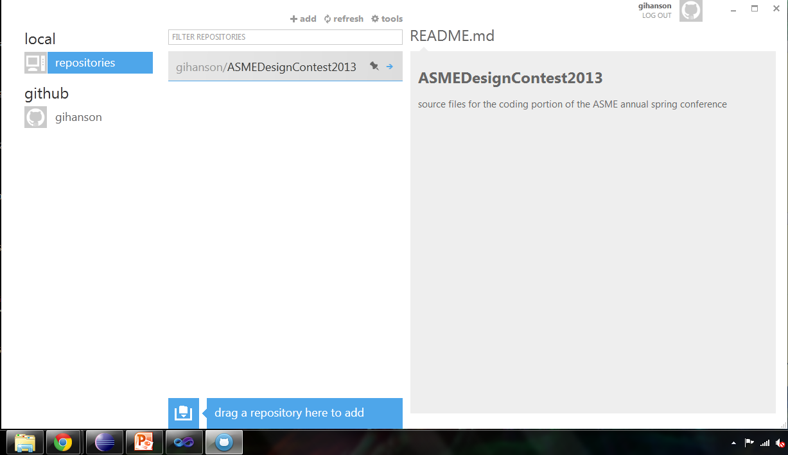
Set Up Git: Part II
Git has a very nice UI (User Interface) which was installed in one of the previous steps. There should be a shortcut on your desktop after installation
Open the shortcut and click on “tools” on the UI which appears and then click “options” from the drop down list

Slide 8
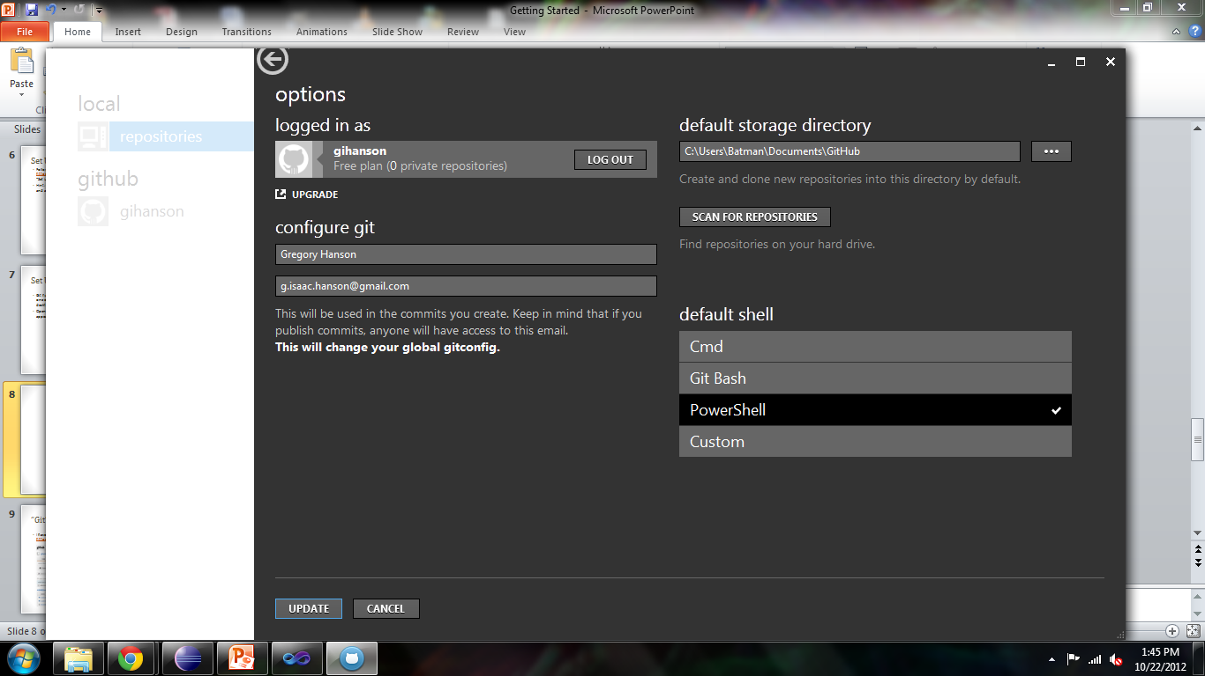
Set Up Git: Part III
Note the location of the default storage directory – this is where any repos you clone will be placed
If you decide to change the location, remember to click “update”!

Slide 9
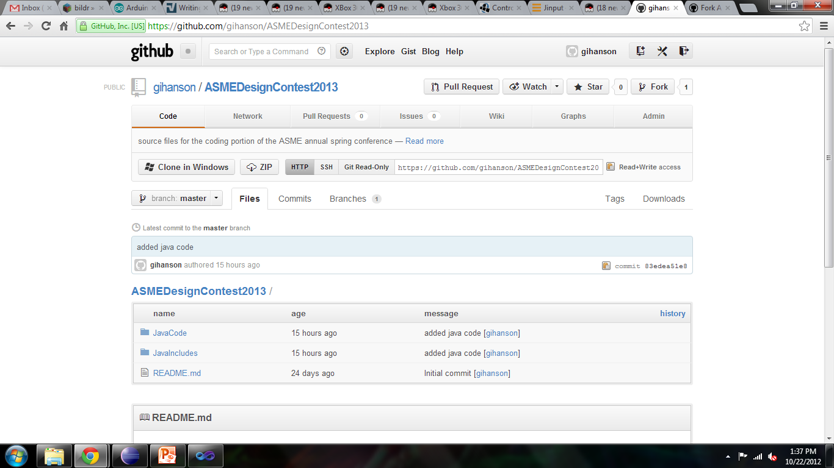
“Git” The Code
I have uploaded some Java code to this repo (log in to your GitHub account before clicking link): https://github.com/gihanson/ASMEDesignContest2013
Select “Clone in Windows” (you may be prompted for administrator permission – click yes). This will open the UI from the slide Set Up Git: Part II and clone the repo

Slide 10
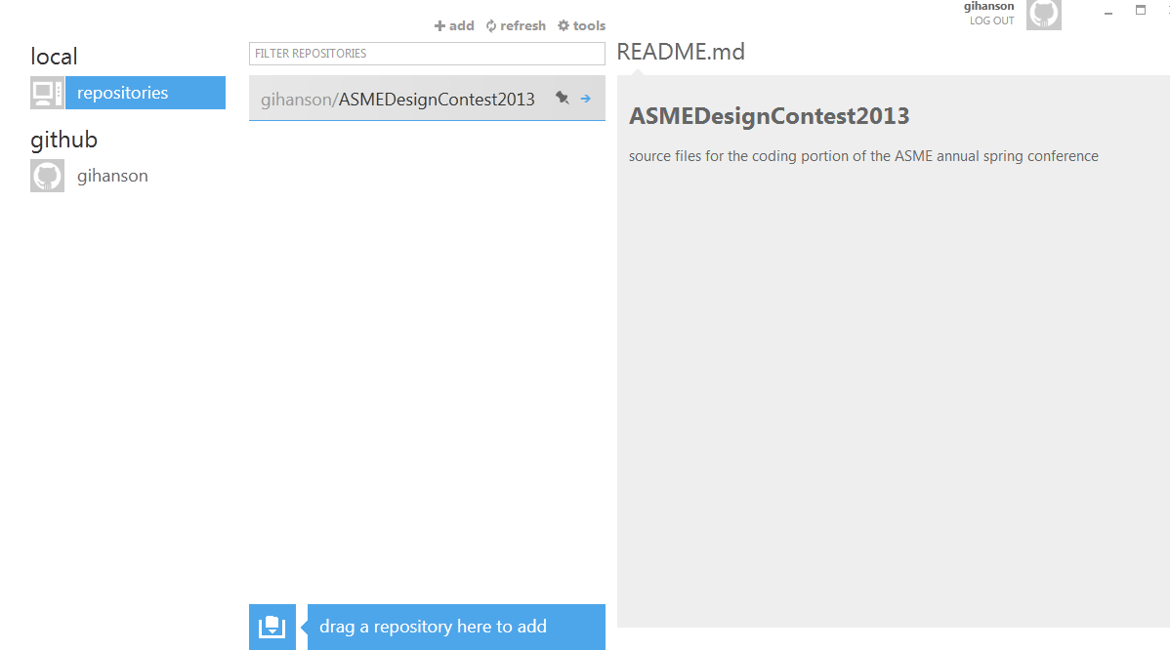
The Repo Has Been Cloned!
Note that after a few second, now the UI should display the repo you cloned

Slide 11
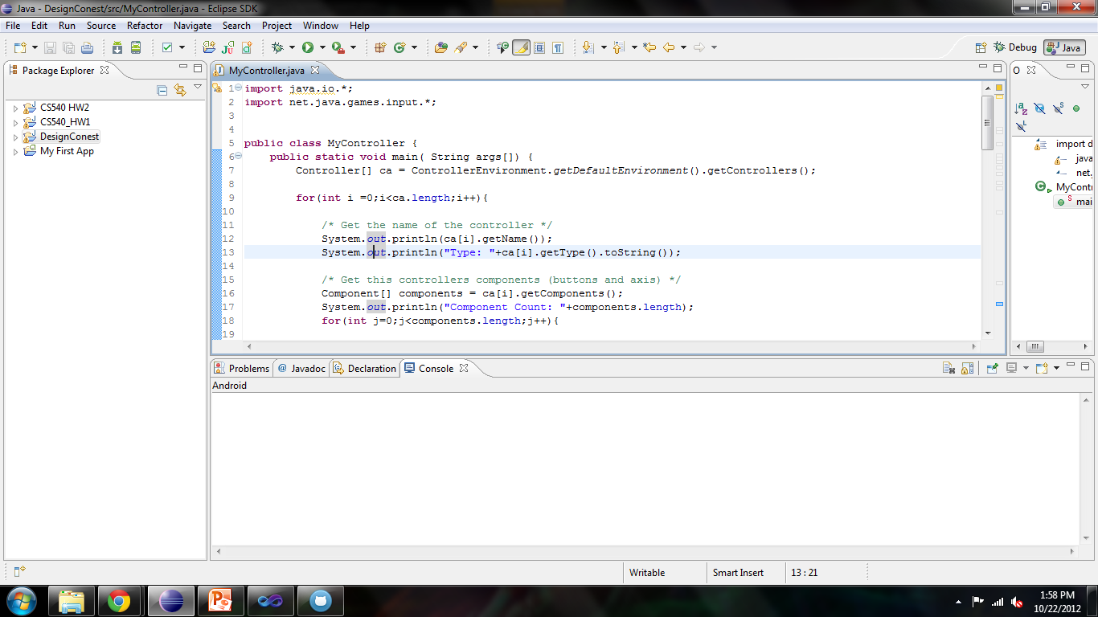
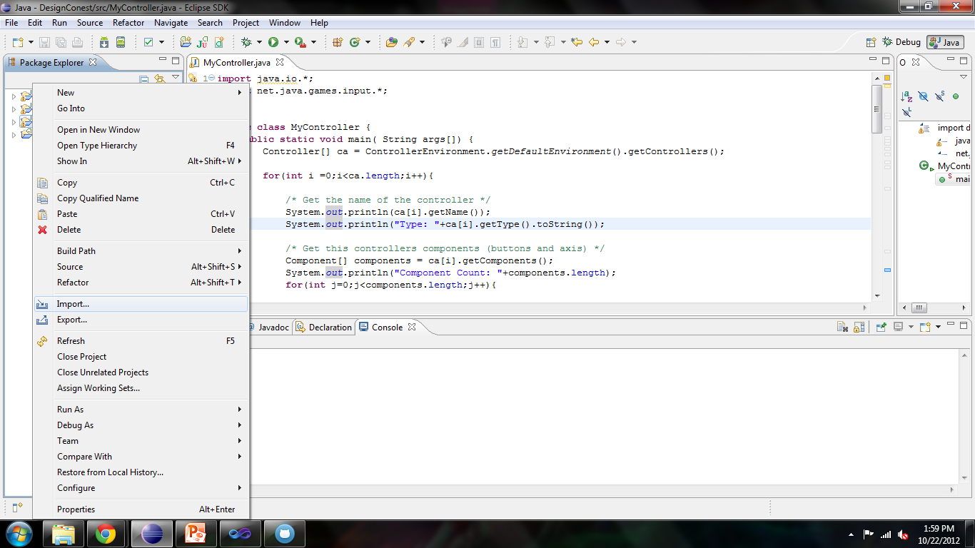
Using the Code – Eclipse: Part I
Open Eclipse
Right-Click in empty space in the Package Explorer, and select “Import”

Slide 12
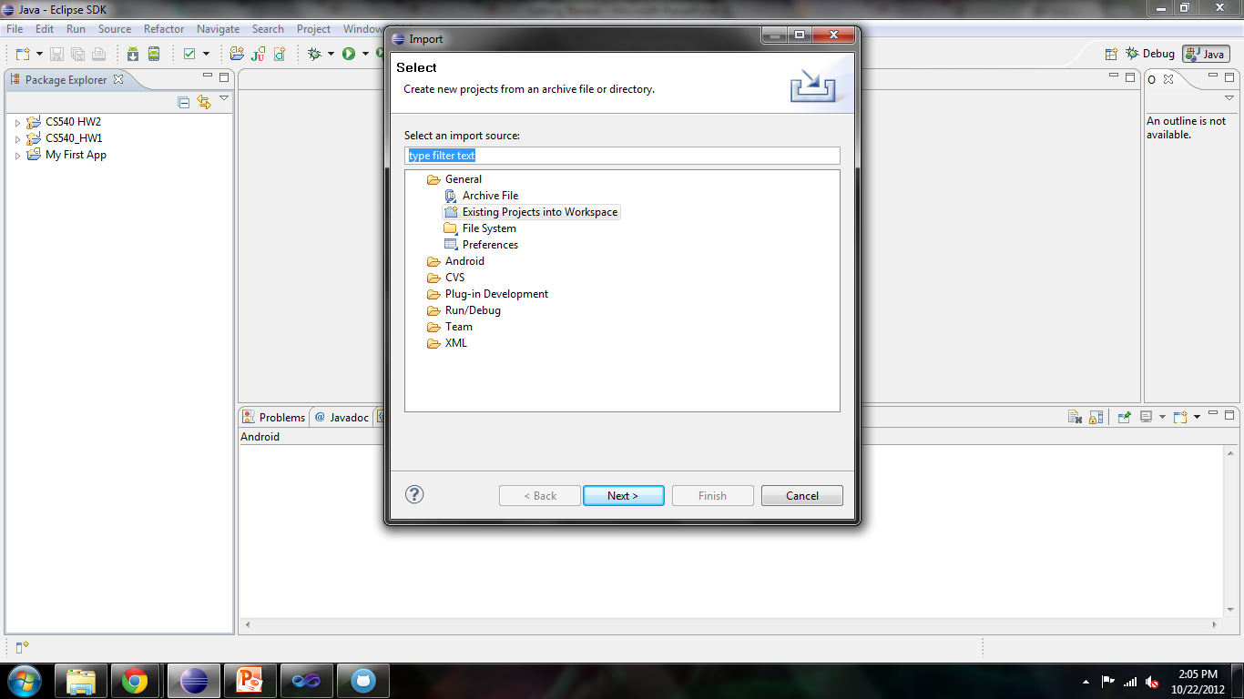
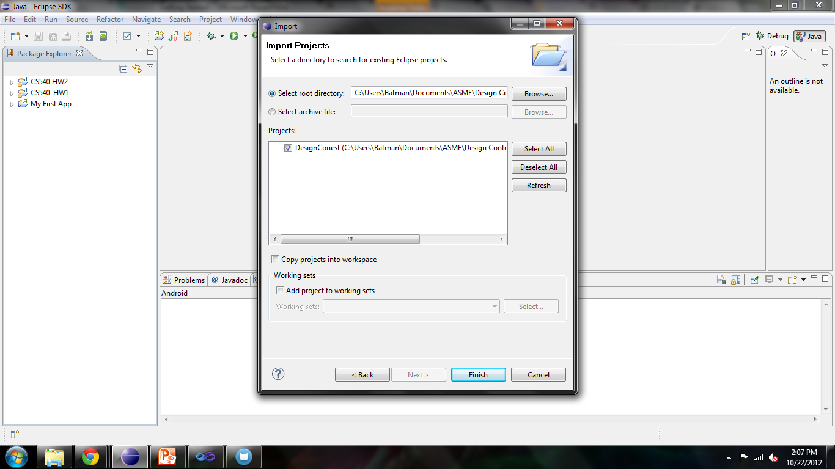
Using the Code – Eclipse: Part II
In the pop-up, select “General->Existing Projects into Workspace”
Browse to the location of the repo folder and browse to ASMEDesignContest2013\JavaCode\
If the right folder is selected, DesignContest should appear in the Projects Box with a check box next to it
Click “Finish” to add the project

Slide 13
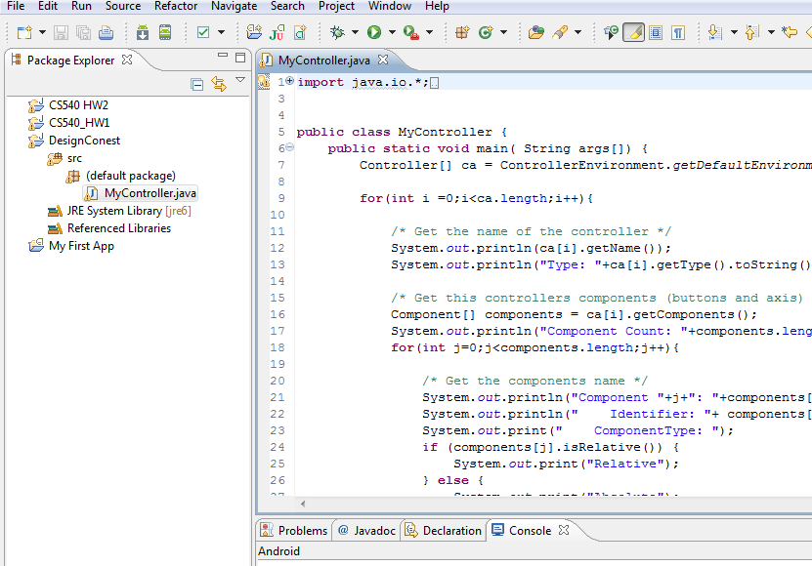
Using the Code – Eclipse: Part III
The project should now appear in your package explorer
Expand the folders until you get to DesignContest->src->default Package and then double-click MyController.java to open
If there are any errors in MyController.java (i.e. things underlined in red) proceed the next slide Adding Libraries, else go to Running The Program

Slide 14
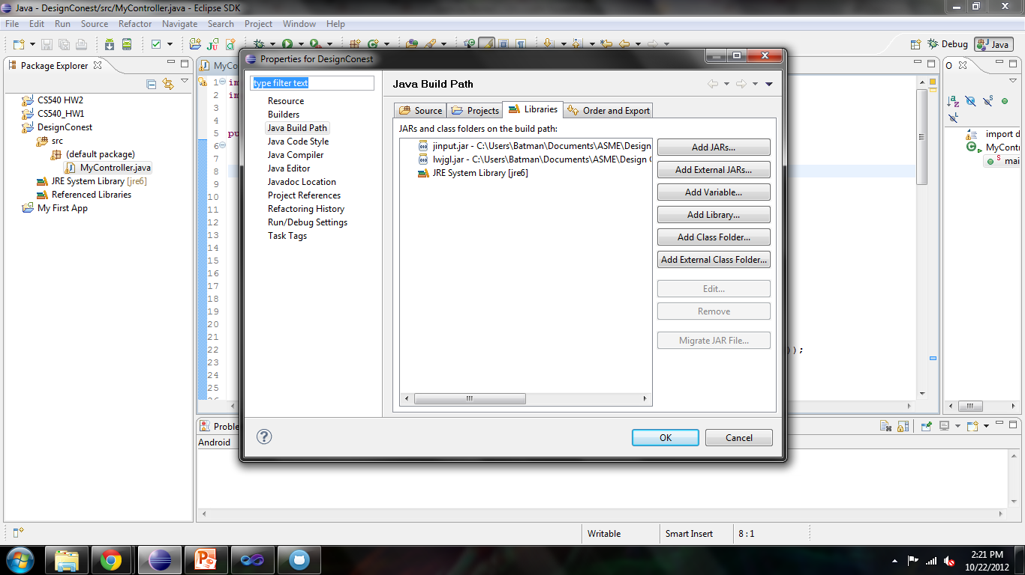
Adding Libraries: Part I
Right-Click on DesignContest from the Package Explorer and select “Properties”
From the pop-up, click on “Java Build Path” from the left menu
Select “Libraries” tab
If the jinput.jar and lwjgl.jar are already there, highlight them and then click “Remove”
Click “Add External Jars”
In the pop-up File Explorer, browse to your repo location and go to ASMEDesignContest2013\JavaIncludes\lwjgl-2.8.4\jar and highlight both “jinput.jar” and “lwjgl.jar”. Then click “Open”

Slide 15
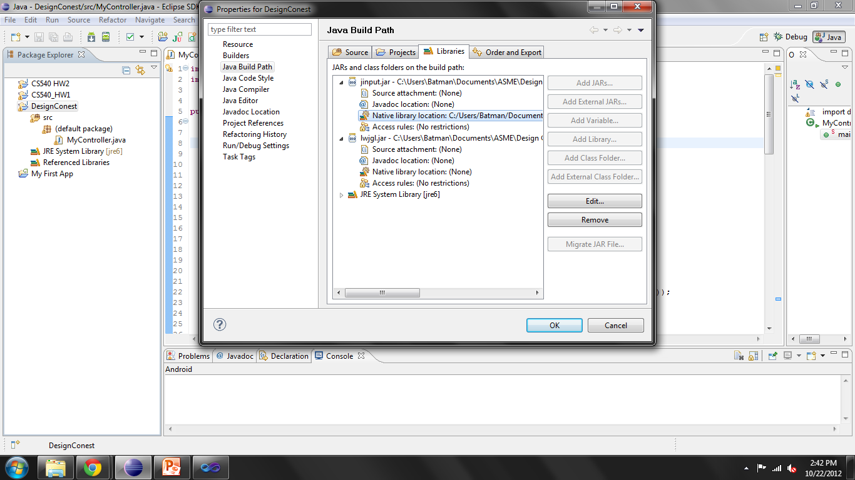
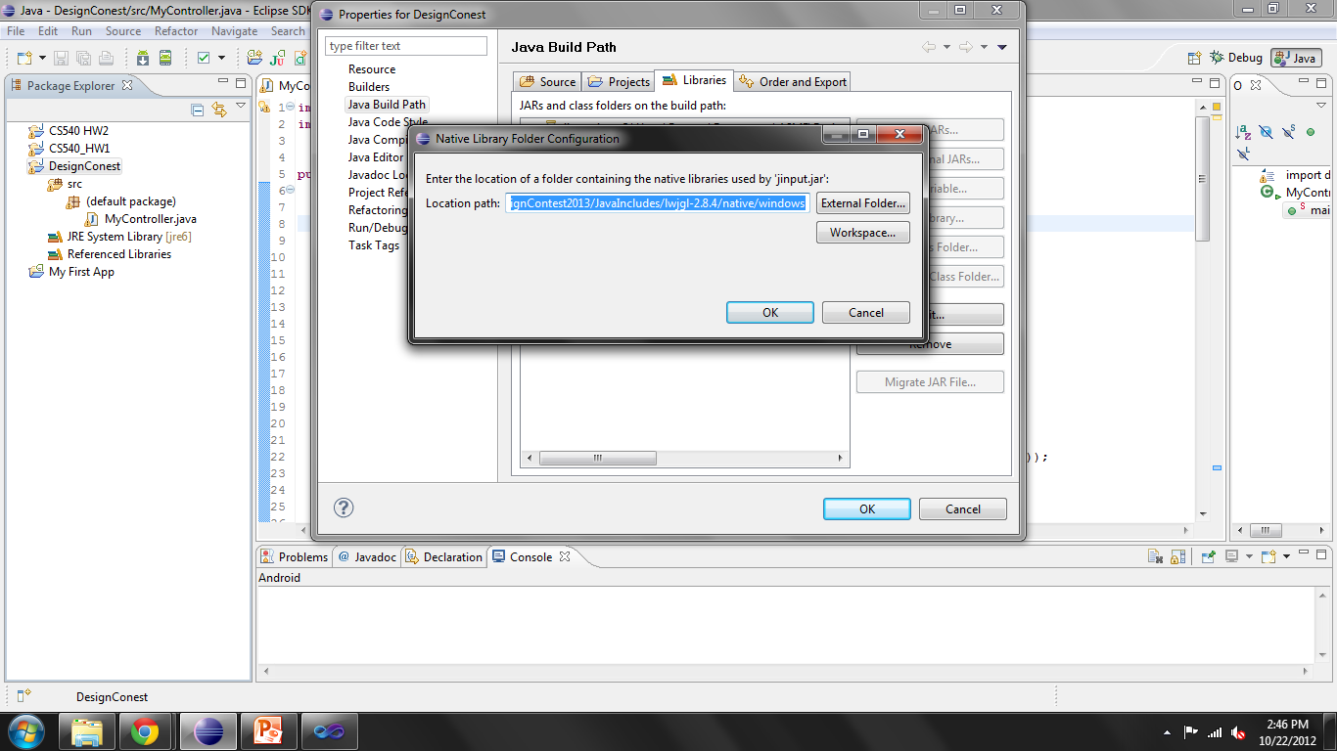
Adding Libraries: Part II
Jinput.jar and lwjgl.jar should now appear under the Libraries tab.
Expand the two jars – notice the Native Library Location is (None). Double-Click one to edit
In the pop-up, select “External Folder…” and browse to your repo location and go to ASMEDesignContest2013/JavaIncludes/lwjgl-2.8.4/native/{your operating system}. Click “Okay” and “Okay” again
Repeat for second .jar file then click “Okay ” to exit Properties window
Red lines should be removed from your program

Slide 16
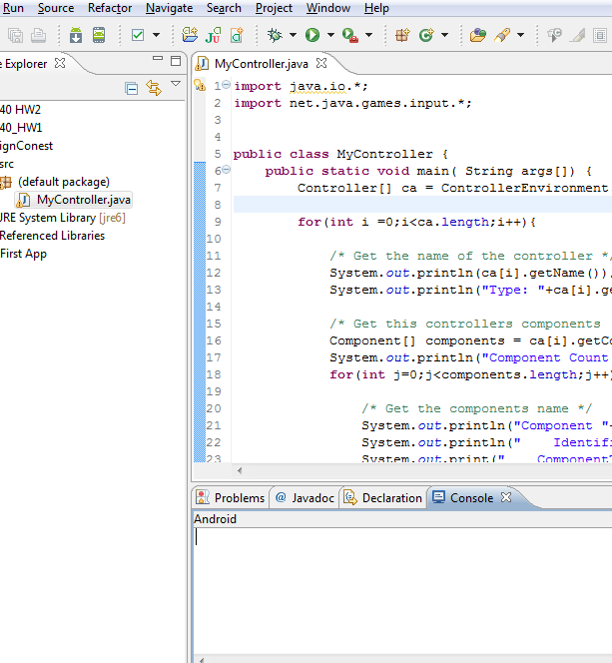
Running The Program
Click the drop-down arrow to the right of the green play/run button and select Run As->Java Application
In the Console output box, the program will list off the various forms of input currently connected to your computer (i.e. mouse, keyboard) and the types of buttons/inputs associated with each
The program is an infinite loop currently. To stop the program, click the red square found on the top right of the console output box

Slide 17
Going a Step Further
If you own an XBOX 360 controller you may perform the following steps. If not, continue to the next slide.
Plug a wired 360 controller into one of your computer’s USB ports – your computer may automatically download the drivers for you. If not you can download the drivers here: http://www.microsoft.com/hardware/en-us/p/xbox-360-controller-for-windows#support
You will know the drivers have successfully been installed when you plug in your controller and the light around the XBOX home button on the controller selects a player position
Re-Run the java program. The Xbox controller should show up in the outputted list of input devices. Also, as you push buttons on the controller, it should print info out

Slide 18
Further Reading
I don’t have a tutorial yet for programming with the Arduino but in the mean time, you may download their programming environment here: http://www.arduino.cc/en/Main/software
If you open the software, you can open up some example code to see some very basic Arduino programs by going to File->Example->Basics->Blink
Note you won’t actually be able to run these examples unless you have an Arduino – they are just for you to get an idea of how to program an Arduino
Also if you want to see how we will be controlling the motors, this site has a great explanation and some sample code: http://bildr.org/2012/04/tb6612fng-arduino/

Slide 19
Feeling Really Ambitious?
Do you have a smartphone? After a comment someone made at the design meeting last week, I started looking into apps for converting your smartphone into a bluetooth webcam. You connect your pc to your phone via bluetooth and you can view the footage on your computer. I like the idea because it could remove the need for internet to communicate with the car and view the video feed. I tried SmartCam and DroidCam (both free apps from the app store). Both have something to install on your phone and pc. I wasn’t too pleased with the delay times on my phone but if anyone is interested in trying one of these applications or another on their phone and gets good results you should let me know. I do not know if there is an iPhone app equivalent for this type of software since I have android.

Slide 20
REWARD! (of course I put it at the very end)
Congratulations, either you have successfully read through the entire tutorial or skipped to the end (boo), either way here are some links to some simple HTML5/JavaScript games written by guys over at the UPL in the CS building
https://mywebspace.wisc.edu/altekruse/web/mitchell.html
A/D: backwards/forwards, space: jump, left-mouse-click: fire laser
https://mywebspace.wisc.edu/altekruse/web/gravity_simulator.html
Shoot the faces with mouse click
https://mywebspace.wisc.edu/gihanson/web/CommanderKeen/Commander_Keen.html
This one’s mine, instructions are on the screen

